Slide 1
The Community Perspective women living with HIV from Africa
Jacque Wambui
AfroCAB Representative
IAS 2019

Slide 2
The Community Perspective’s on ATI and Remission Trials
Jacque Wambui
AfroCAB Representative- Kenya
IAS 2019
@jcqwambui
Share your thoughts on this presentation with #IAS2019

Slide 3

What is An ATI?
Many community members do not know what ATI stands for, let alone understand the complexities of various clinical trials.
Key takeaway: Many community members do not have enough information or involvement.

Slide 4


History of Community Involvement In HIV
When ART was first developed, a common argument was that it could not be rolled out in Africa because the regimens were extremely reliant on time and many Africans did not have watches.
When treatment optimization began, a common argument was that it was too complicated for community members to understand, so that they should not be included.
Will the same happen with ATI and remission trials?

Slide 5
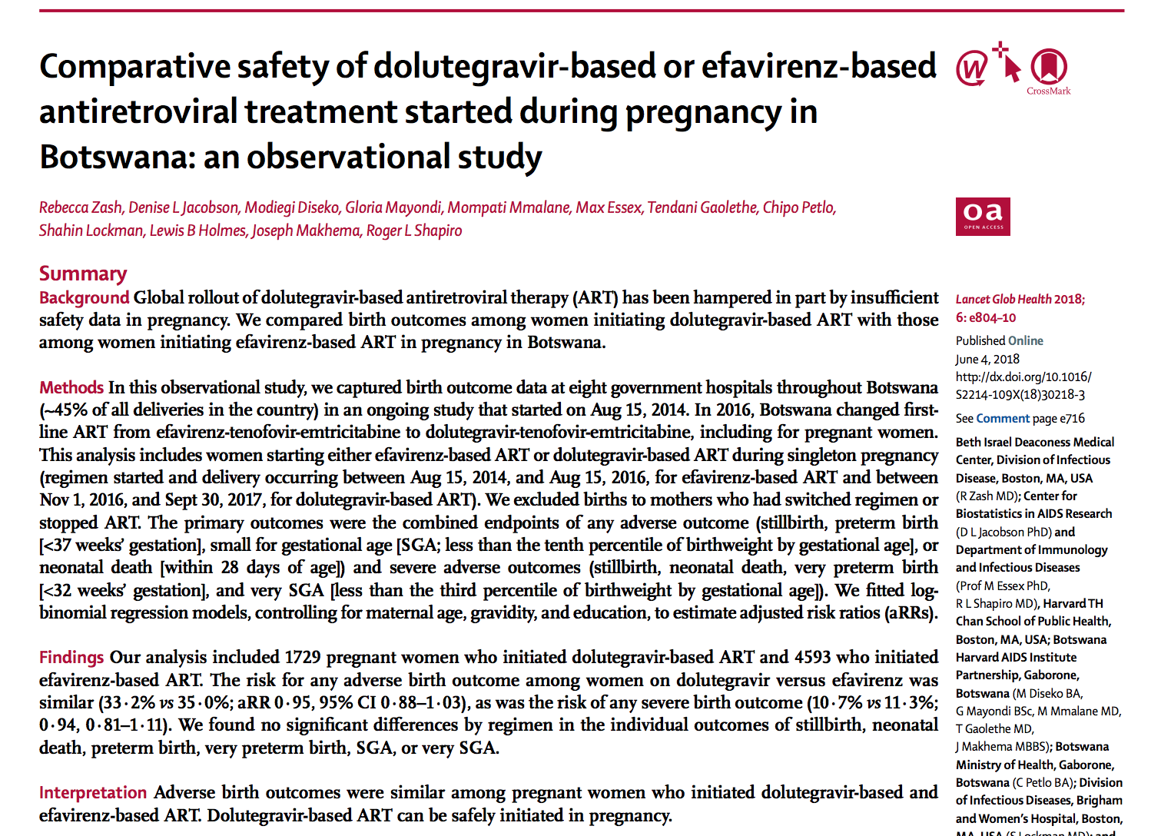
Recent Example Of Community Engagement in HIV Treatment:
Women & DTG
Botswana Tsepamo study interim results indicated a potential link between neural tube defects (NTD) and dolutegravir (DTG) use at the time of conception.
Global and national stakeholders reacted quickly to the safety signal. The messages and directives in the responses varied, but they all have one thread in common: limited to no community consultation.
This means that the global community did not consult the primary population affected by these findings, the women living with HIV, in regards to their own health care decisions.

Slide 6
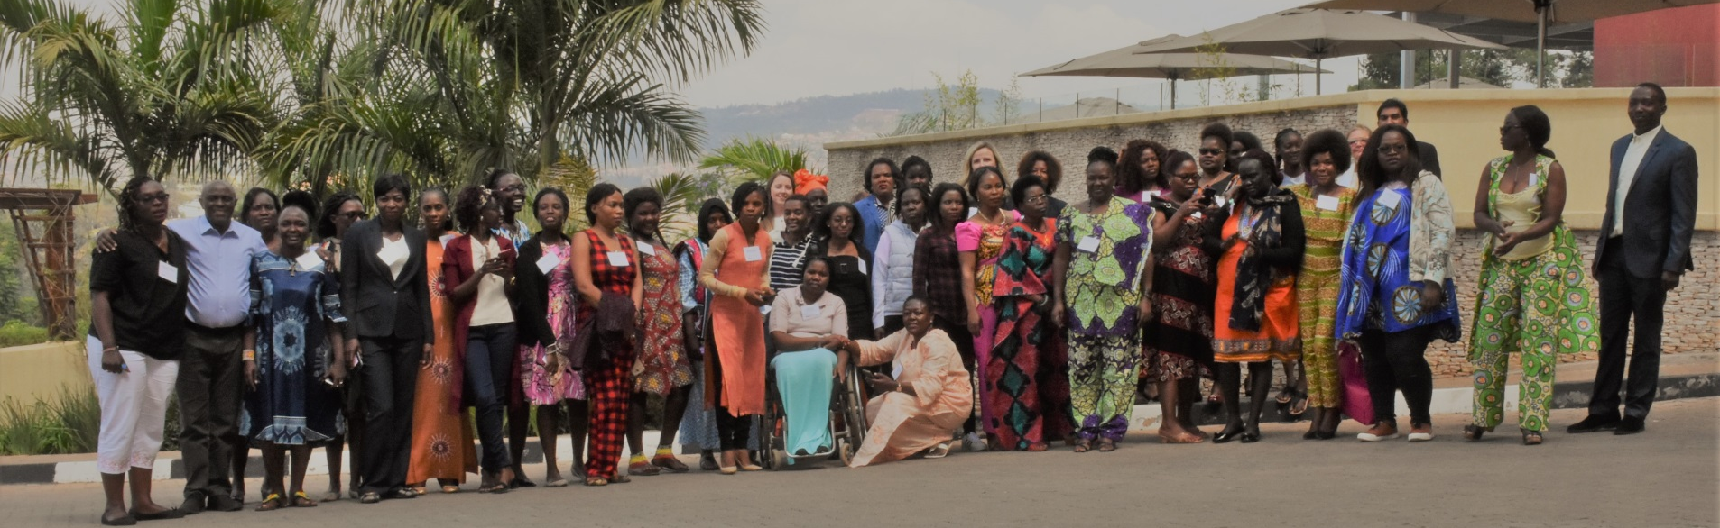
The Kigali Meeting
AfroCAB organized a meeting of 39 women living with HIV representing 18 countries in Kigali, Rwanda on July 13 and 14, 2019 to discuss the potential NTD safety signal and develop a joint position on behalf of women for access to optimal HIV treatment and prevention.

Slide 7
Discussion At the Kigali Meeting
Potential risk similar to the other ARV treatments that are currently available to us. [I.e., NTD is not the only risk of ART]
We are diverse – not all women seek to have children.
We can make decisions about our reproductive health.
We are disappointed at our lack of involvement in decision making in regards to our treatment access.
We believe that, with correct information and contraceptive access, we can make informed choices in using DTG and planning our pregnancy.
This is an opportunity for integrating much-needed access to contraceptives within HIV treatment in order to achieve universal reproductive health care for all.
1
5
2
3
6
4

Slide 8

Outcomes of the Kigali Meeting
Unanimous decision based on the data currently available that DTG’s benefits – reduced side effects, improved efficacy, and a high barrier to resistance – outweigh its potential risks.
Concluded that blanket exclusions that deny women equitable access to this optimal HIV treatment are not warranted or justified.
“We are calling for TLD to be made available urgently across Africa, with everyone having access, regardless of gender or reproductive capability, and with integration of sexual and reproductive health services.”

Slide 9
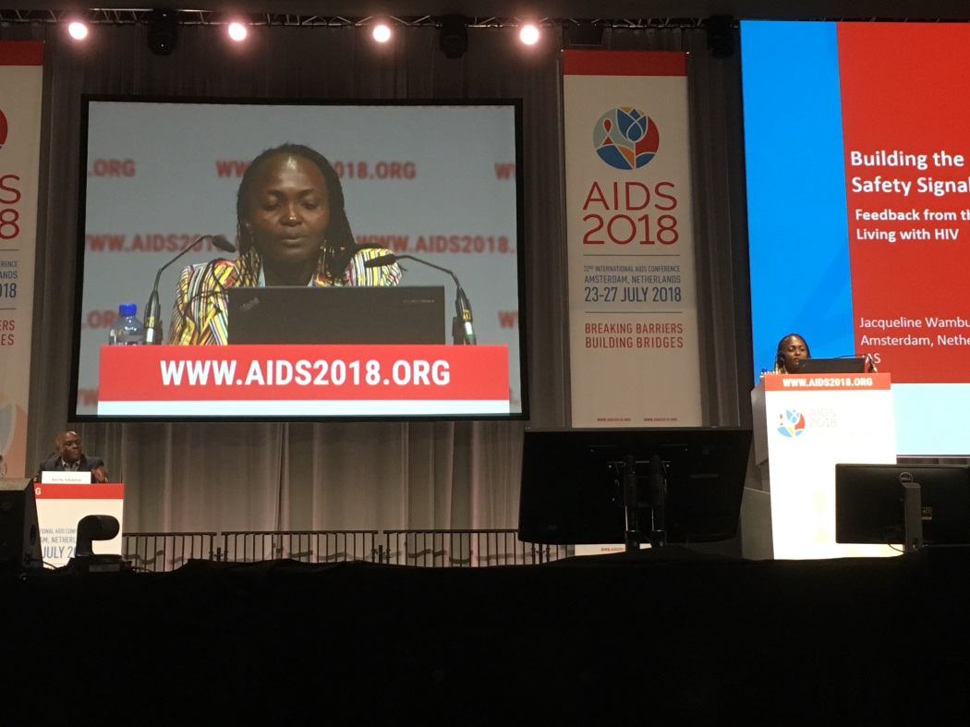
Joint position from Meeting Shared at IAS 2018
“We believe it is critical to not just view a pregnant woman, or any woman of childbearing potential, as a vessel for a baby, but as an individual in her own right, who deserves access to the very best, evidence-based treatment available and the right to be adequately informed to make a choice that she feels is best for her.”
Presenting the joint position statement at IAS 2018

Slide 10
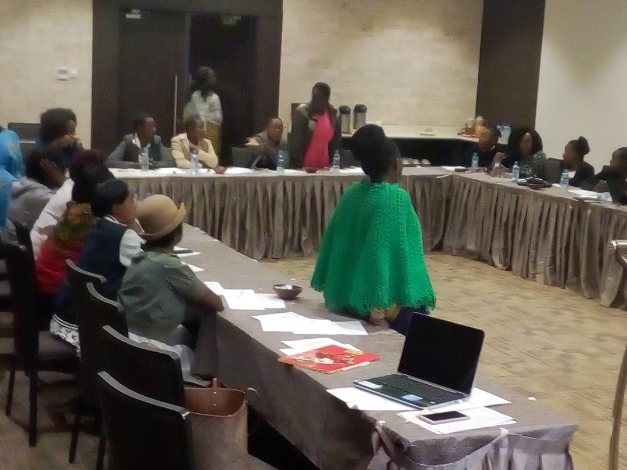
Deep Dive On Engagement: Kenya
Facilitated three community consultations to discuss access to DTG in Kenya among women of childbearing age following the potential neural tube defect (NTD) safety signal for DTG.
Following the first meeting, participants organized a one-on-one meeting with the head of the MOH and wrote a petition to disseminate the recommendations.
The other two consultations were held after the release of the national guidelines and aimed to further understand the experiences, barriers, and challenges women face in accessing DTG and family planning services at facilities.

Slide 11





Best Practices To Engage with Communities
Creating a community advisory board: Leveraging already strong community networks, AfroCAB, CHAI, Unitaid, and HIV i-base created a treatment Community Advisory Board (CAB) to bring civil society’s voice to the center of the treatment optimization agenda
Including community in national policy forums: In 2019, Zimbabwe invited women living with HIV to participate in community dialogues and HIV community advocates to present findings and participate in decision-making forums concerning access to DTG
Inviting community to participate in steering committees for research: Community members served on the Global Community Advisory Group and ECHO trial steering committee
Increasing community participation in global policy forums: In 2019, community members participated in the WHO Guidelines Development Group for HIV Treatment
HIV Treatment Literacy Materials: Radio programs and diverse sets of treatment literacy materials, including pamphlets, brochures, pocket guides, videos, and training manuals, help increase awareness and understanding of new, optimal products and generate demand.

Slide 12
What does this Mean for ATIs? Concerns From The Community
Giving and receiving informed consent
Patient understanding of the difference between “remission” and “cure”
Patient understanding that ATI clinical trials result in different types of outcomes, that are not always of immediate benefit to the patient
What evidence justifies the risks of the trial given what we already know about ATIs

Slide 13
How can We Address these Concerns?
In conducting any human subjects research there must be equipoise, which is true uncertainty about the outcome. If the outcome is known then exposing human subjects to research risk is not ethical.
For the community to appreciate that these ATI experiments are significantly different the participants need to be educated as to why these studies are expected to have different outcomes. And in order for that to happen the subjects need to have a pretty sophisticated understanding of immunology and HIV pathogenesis.
The community’s unified voice that advocated for equitable access and patient choice in DTG rollout defined the global conversation and shifted country responses to the safety alert, we can do the same to ensure that the community is well-informed about these trials and that consent is well-attained prior to the trials.
Notes:
Jacque – Here, I would stress your key takeaway and then fill in with any brainstormed ideas you have on recommendations for moving forward

Slide 14
Conclusion
Although there are risks to ATI and concerns within communities, an HIV cure needs to be developed with a pathway for rapid access to the communities most affected by HIV.
Together, with community engagement, we can increase access and avoid excluding low- and middle-income countries in the search for a cure.

Slide 15

Thank you!
Acknowledgments:
This work is made possible by the generous support and partnership of Unitaid

